Slide 1
Using GSR data for determining cognitive load
Guido Zuidhof
Bachelor artificial intelligence
December 2014
SUPERVISORS
PASHIERA BARKHUYSEN
LOUIS VUURPIJL
ERVIN POLJAC

Slide 2
Outline
How to determine cognitive load from biometrics?
What is Cognitive Load
Biometrics used: GSR
Experiment
First results
Next steps

Slide 3
Cognitive Load
The amount of information a human is trying to process in working memory at any one time.
(Sweller, 1999)
Cognitive Limit “Cognitive overload”
Classroom Applications
Automatic difficulty adjustment
People on the autism spectrum do display physiological response
“You should take a break”
Notes:
Classroom applications
Automatic difficulty adjustment in applications (such as games)
“You should take a break”
People on the autism spectrum do display physiological response

Slide 4
Cognitive load measurement
Many approaches to measuring cognitive load
R. Brünken et al. (2003), Direct Measurement of Cognitive Load in Multimedia Learning. Educational Psychologist 38(1), 53-61
 | Indirect | Direct
Subjective | Self-reported invested mental effort | Self-reported stress level Self-reported difficulty of materials
Objective | Physiological measures Behavioral measures Learning outcome measures | Dual-task performance Brain activity measures (e.g. fMRI) (arguably also indirect)

Slide 5
Cognitive load measurement
Many approaches to measuring cognitive load
 | Indirect | Direct
Subjective | Self-reported invested mental effort | Self-reported stress level Self-reported difficulty of materials
Objective | Physiological measures Behavioral measures Learning outcome measures | Dual-task performance Brain activity measures (e.g. fMRI) (arguably also indirect)

Slide 6
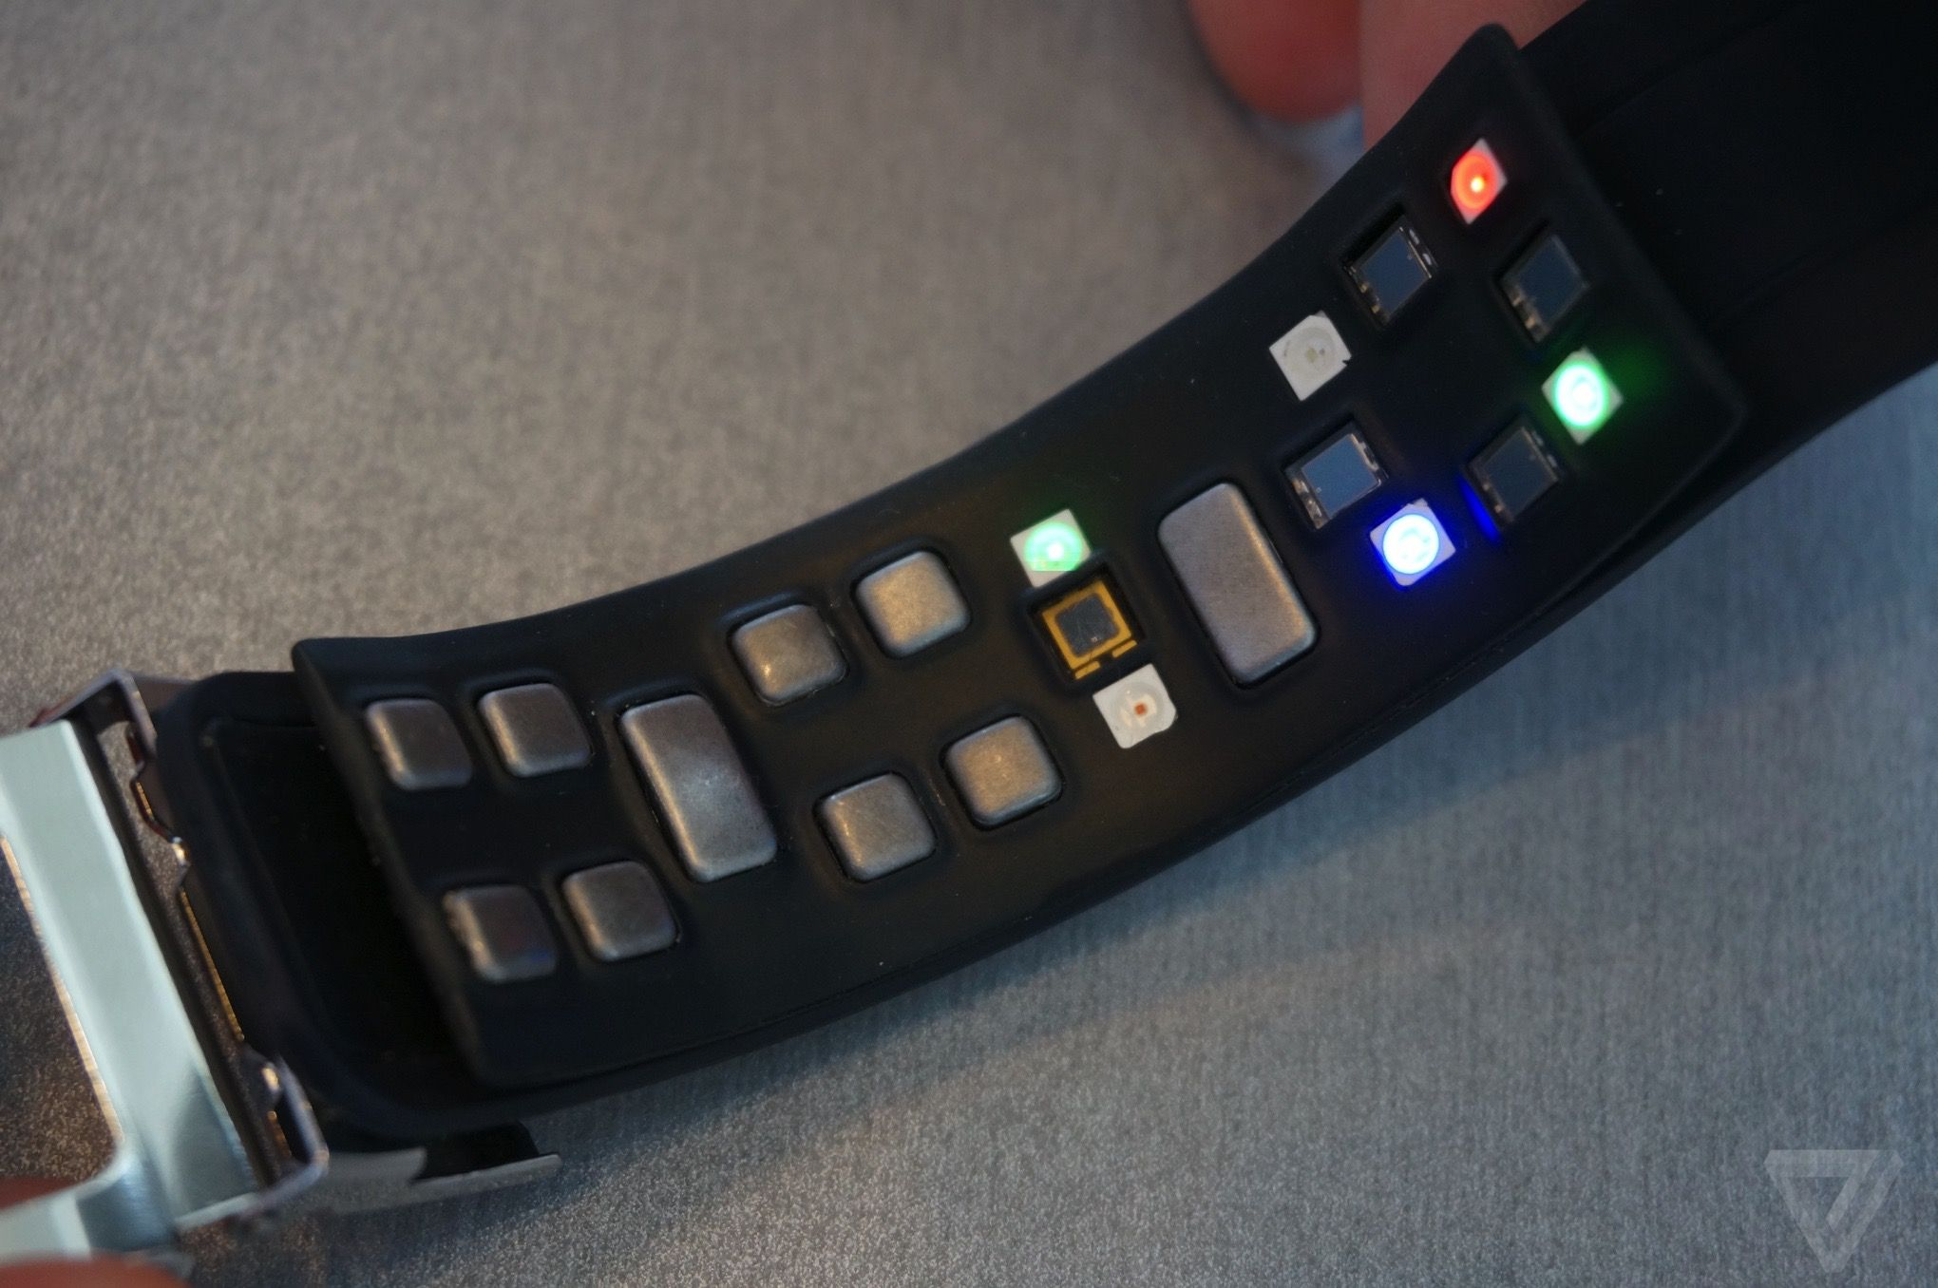
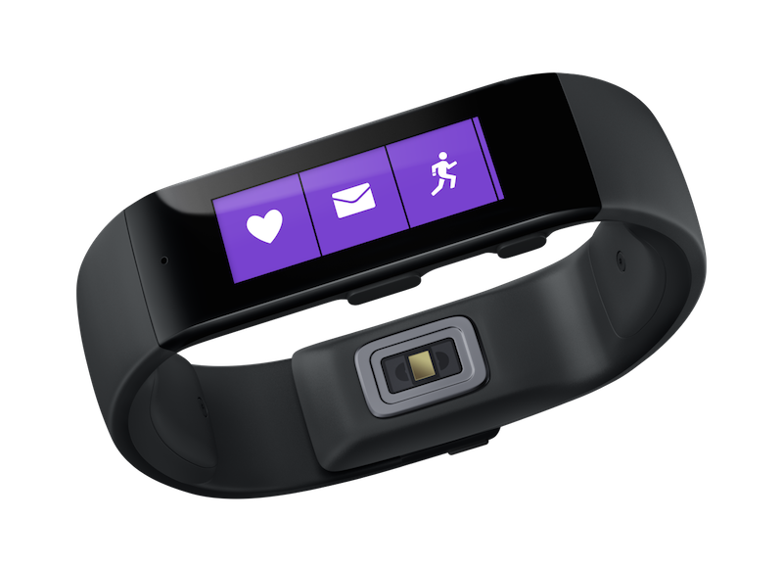
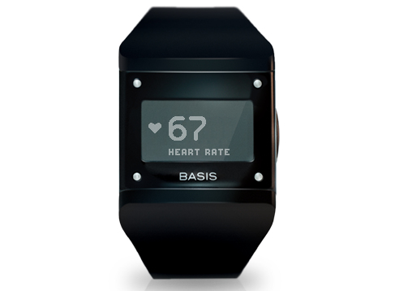
New consumer electronics can measure biometrics
APIs are generally lacking, data is locked in proprietary apps
Samsung Simband
Microsoft Band
BASIS Watch

Slide 7
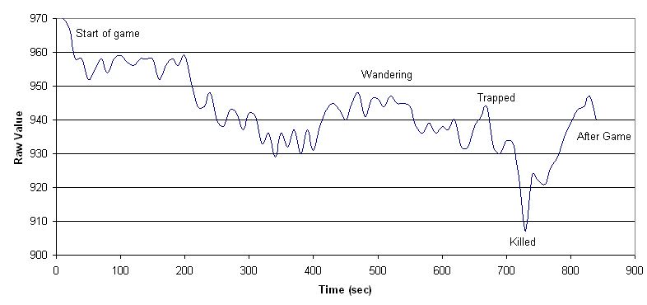
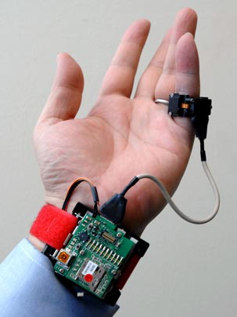
Physiological response
The body responds when cognitive load is increased/reduced
Many different options for measuring, like:
Blood oxygen level
Skin temperature / heat flux
Blood pressure
Motion (accelerometer)
Heart rate variability (HRV)
Respiratory rate
Galvanic Skin Response
Facial expressions
Pupil dilation
Blink rate
Notes:
Multiple can be measured simultaneously

Slide 8
Physiological response
The body responds when cognitive load is increased/reduced
Many different options for measuring, like:
Blood oxygen level
Skin temperature / heat flux
Blood pressure
Motion (accelerometer)
Heart rate variability (HRV)
Respiratory rate
Galvanic Skin Response (GSR)
Facial expressions
Pupil dilation
Blink rate

Slide 9
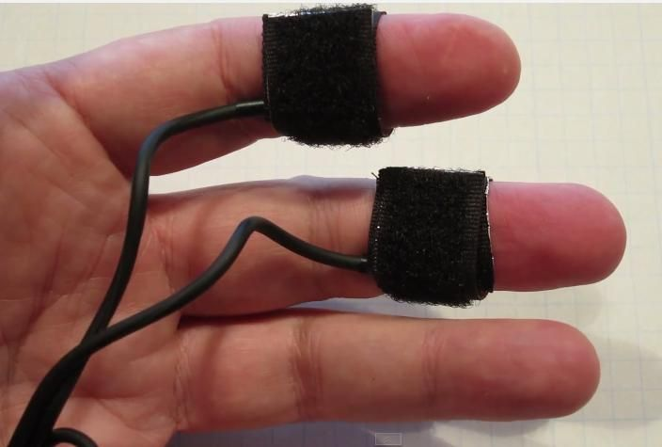
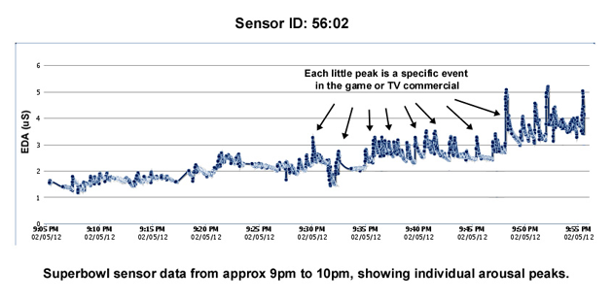
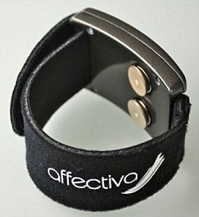
Galvanic Skin Response (GSR)
Measuring the electrical skin conductance
Small voltage applied to electrodes, flowing current measured
Unit of measurement: μS (microsiemens)
Influenced by sweat glands
Delay between stimulus and response between 0.8 and 4 seconds
Notes:
GSR is measuring the electrical skin conductance,
Unit of measurement is micro siemens
More sweat -> higher conductance, sweating caused by primitive ‘fight or flight’ response, preparing for exertion to deal with threat
Delayed response

Slide 10
Method
Measure GSR data using tasks with varying difficulty
Classify task difficulty from features of the GSR data

Slide 11
Experiment
Arithmetic tasks with varying difficulty, that evoke cognitive load (based on [1])
Addition of four numbers, presented one by one
4 difficulty levels
8 tasks per subject, in random order
Difficulty | Example Task
1 | 0 + 1 + 1 + 1
2 | 3 + 5 + 7 + 2
3 | 31 + 40 + 67 + 24
4 | 163 + 721 + 573 + 594
[1] Nourbakhsh et al. 2012 , Using galvanic skin response for cognitive load measurement in arithmetic and reading tasks.

Slide 12
***

Slide 13
48

Slide 14
71

Slide 15
50

Slide 16
34

Slide 17
203
196
199

Slide 18
203
196
199

Slide 19
**

Slide 20
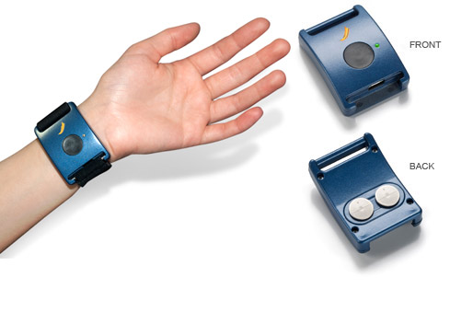
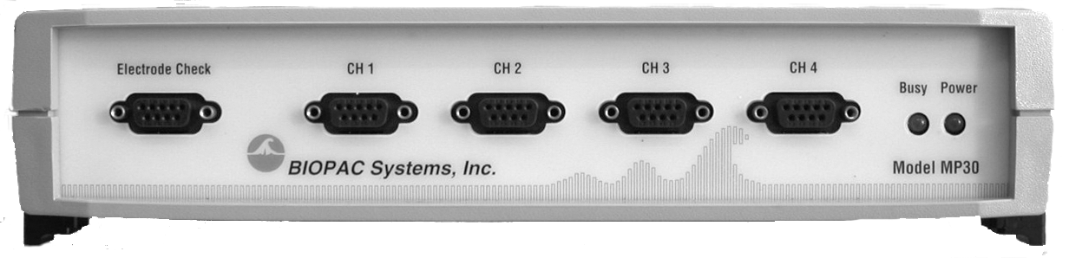
Apparatus
Affectiva Q Sensor (dry electrodes on wrist)
BIOPAC MP30
(wet finger electrodes)

Slide 21
Q Sensor Data (explorations)
Data proved unusable, proper connection to skin not present in many subjects
Needs some sweat present from the get-go
Lesson learned:
Have subjects wear them longer before the first task starts
Ask subjects to do some mild exercise beforehand

Slide 22
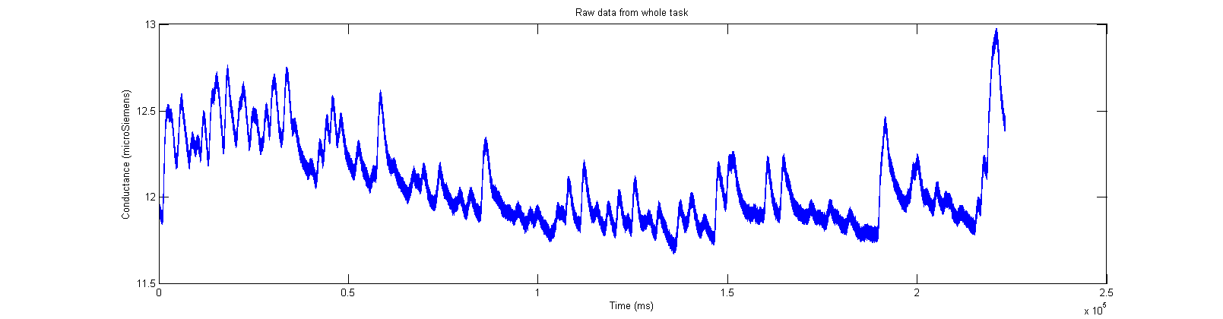
Raw data (biopac)

Slide 23
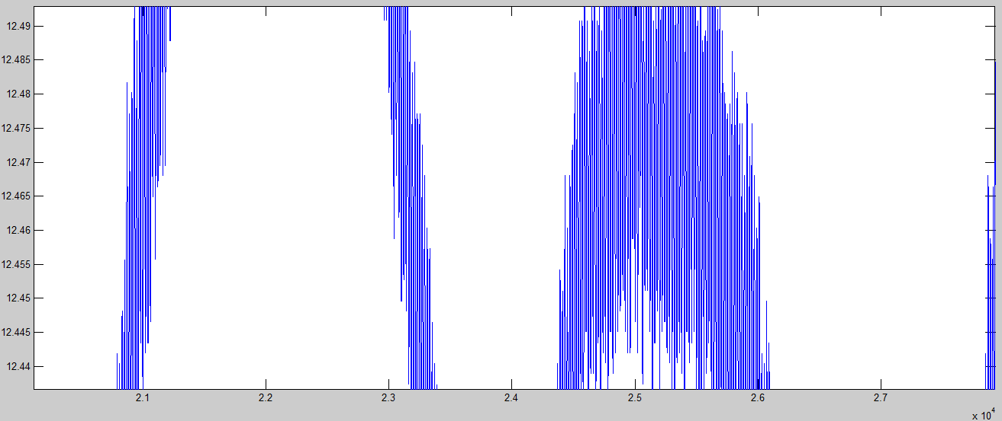
Raw data
DC current noise (50Hz) in signal

Slide 24
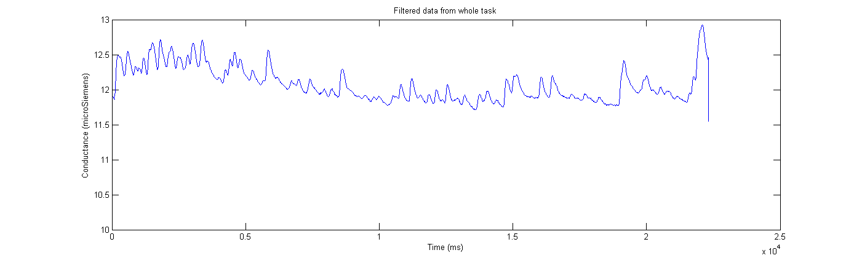
Preprocessing
Smoothing filter (removing DC current)
(Savitzky-Golay filtering)
Notes:
Low Pass Filter didn´t cut it

Slide 25
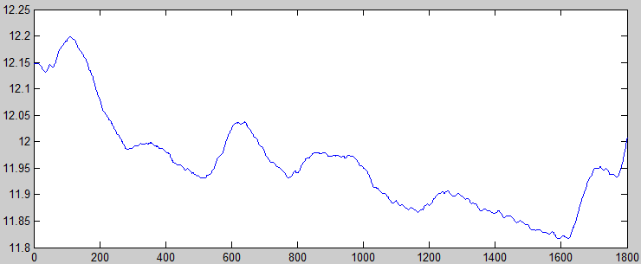
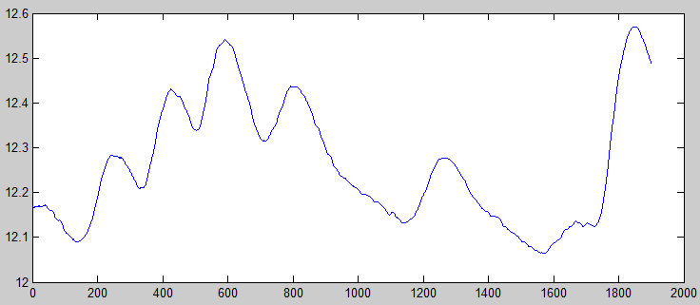
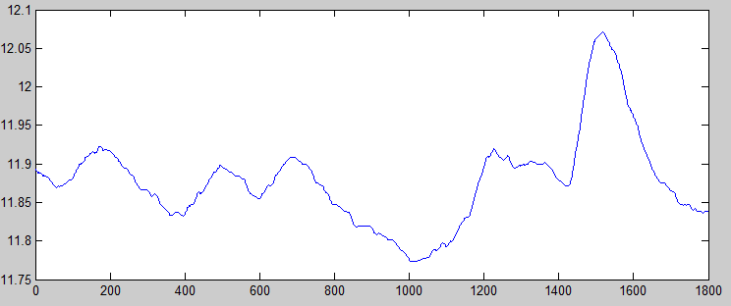
Preprocessing
Cutting the tasks out of the data
...

Slide 26
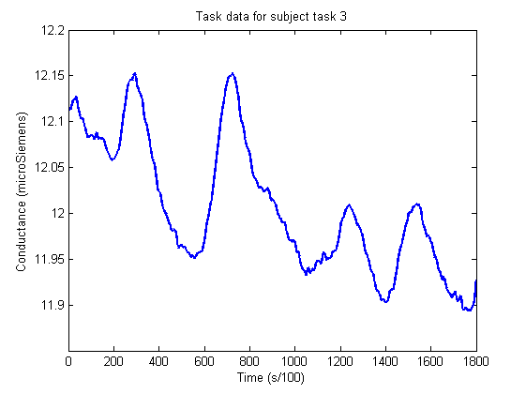
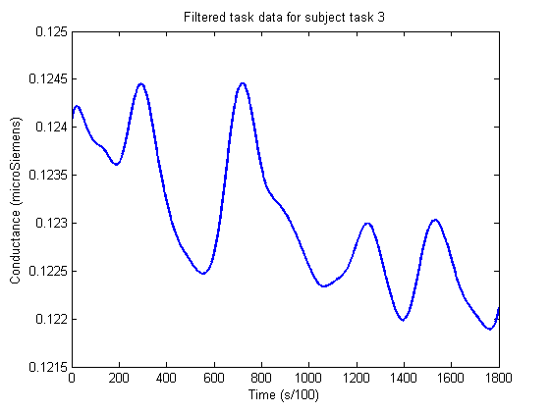
Final preprocessing
Normalizing (dividing by subject average GSR over all tasks)
Smoothing out small DC current spikes (Savitzky-Golay filtering)

Slide 27
Transformation
Extract time domain features
Export to an easily parsable format (CSV)
'luc' 'diff2' [221.4503] [0.1230] [7.3118e-04] [0.0020] [6] [6] [5] [4]
Subject, Difficulty,
Accumulative GSR, Average GSR
Standard Deviation, Difference start/end
Peak count with varying tresholds

Slide 28
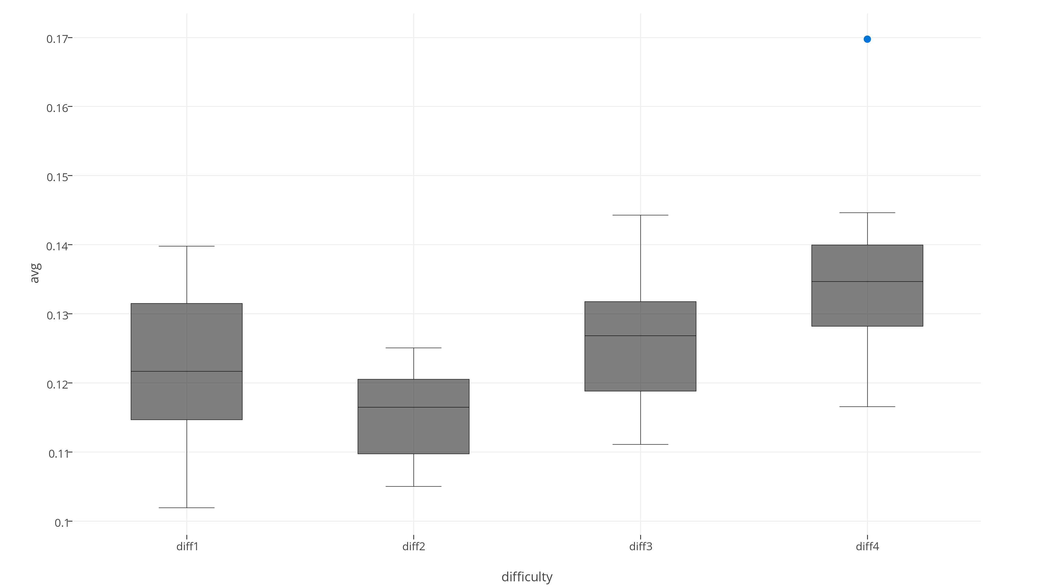
Visualization
Average GSR

Slide 29
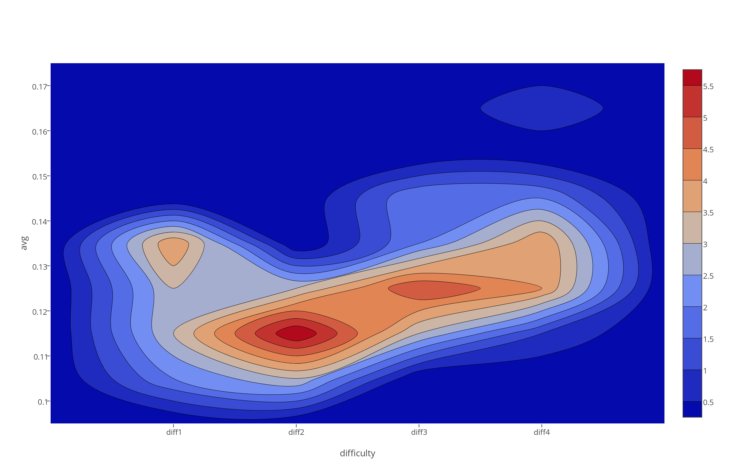
Visualization
Average GSR

Slide 30
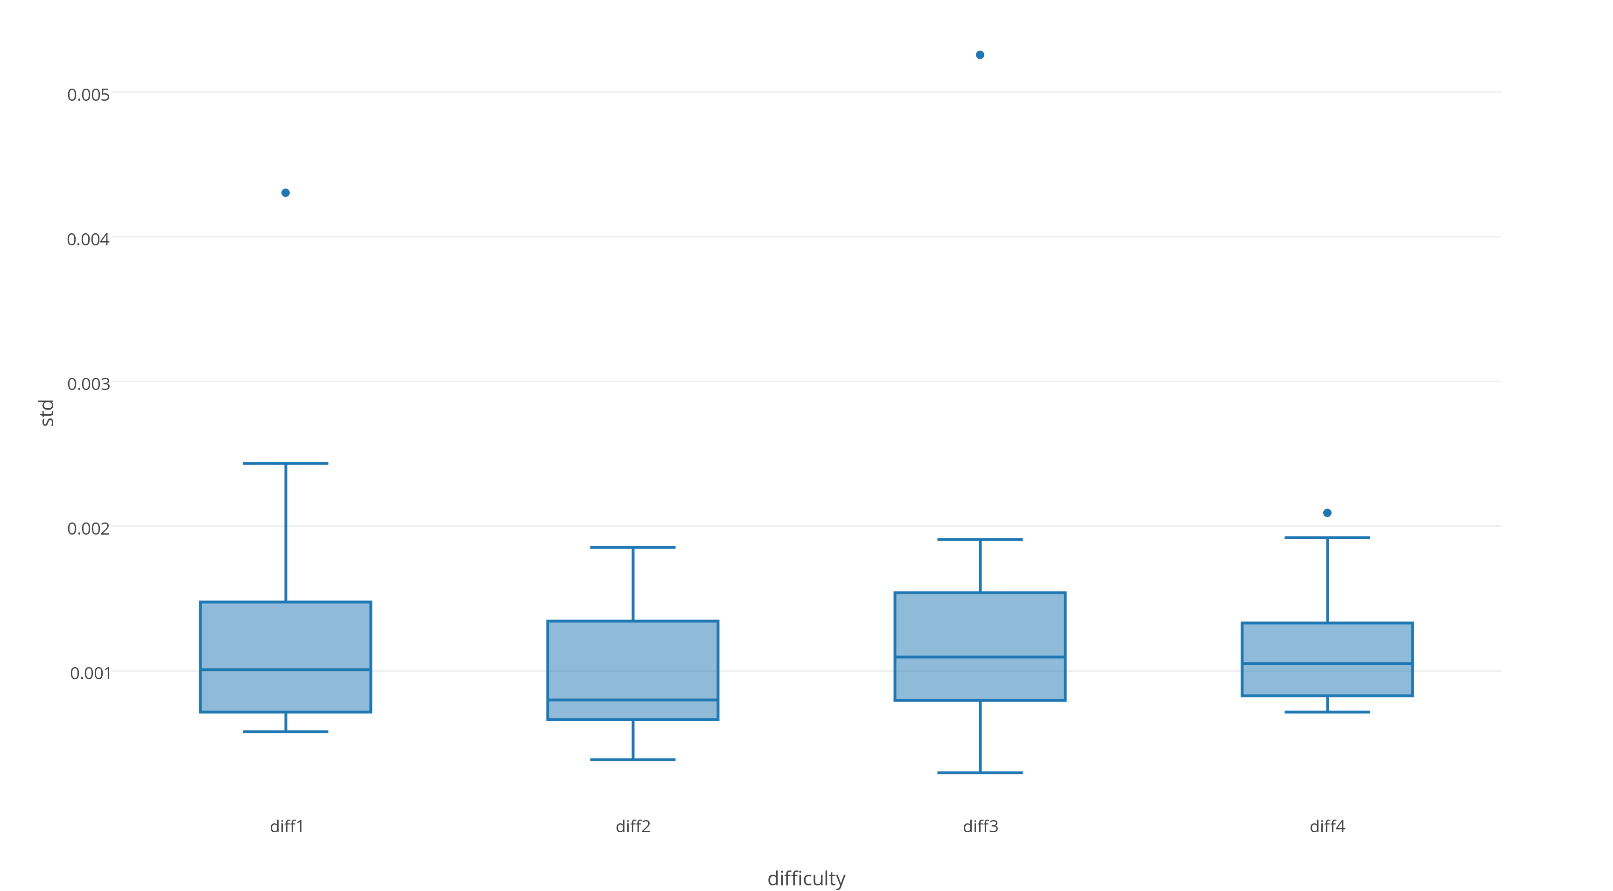
Visualization
Standard Deviation

Slide 31
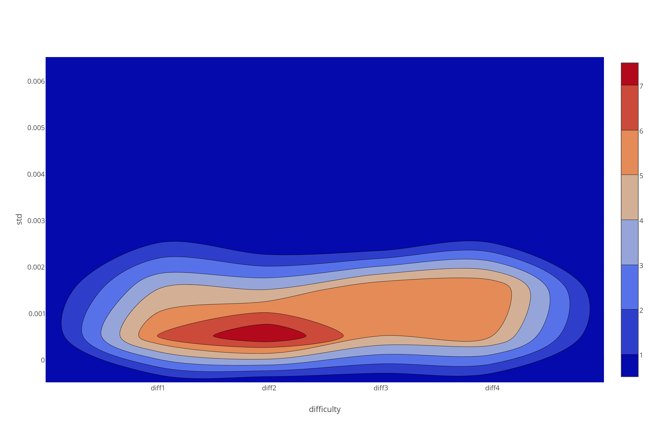
Visualization
Standard Deviation

Slide 32
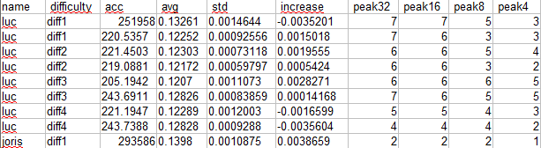

Building a classifier
CSV data fed to Weka Data Mining Software
Easy to try multiple classifier training algorithms

Slide 33
Classification
Can we predict the task difficulty given these features?
Notes:
And thus say something about cognitive load of the person

Slide 34
Preliminary results
10 Folds cross-validation was used
Classifier | Correctly Classified Instances %
SimpleCart (Minimal Cost Decision Tree) | 33.33%
J48Graft (Decision tree) | 43.75%
BayesNet (Bayesian probability estimation) | 25%
Naïve Bayes | 33.33%
LWL (Locally weighted learning) | 41.67%
Multilayer Perceptron (20 hidden layers) | 29.17%
SMO (Support Vector Machine class algorithm) | 6.25%
JRIP (Rule based learner) | 18.75%
Simple classifiers seem to work best. Expected from small dataset size.
Notes:
Note that 25% is expected from chance
Reasonable

Slide 35
Preliminary results
10 Folds cross-validation was used
Classifier | Correct % 4 classes | Correct % 2 classes
SimpleCart (Minimal Cost Decision Tree) | 33.33% | 72.92%
J48Graft (Decision tree) | 43.75% | 77.08%
BayesNet (Bayesian probability estimation) | 25% | 75%
Naïve Bayes | 33.33% | 60.42%
LWL (Locally weighted learning) | 41.67% | 75%
Multilayer Perceptron (20 hidden layers) | 29.17% | 62.50%
SMO (Support Vector Machine class algorithm) | 6.25% | 58.33%
JRIP (Rule based learner) | 18.75% | 79.12%
Notes:
Classifying between task 1,2 and task 3,4 combined
50% expected from chance.
Still not great / good enough

Slide 36
Improving the classification
Classification accuracy is reasonable, not great. Possible reasons:
Small dataset (6 participants * 8 tasks = 48 entries)
Experiment
Design susceptible to ´task bleeding´, i.e. sweat from last task carries over
Sensor inaccuracy
Do these tasks evoke sufficient cognitive load difference?
Not the right features extracted from data
It is simply not classifiable better from GSR

Slide 37
Recap
Using biometrics to determine cognitive load outside of the lab is exciting
I measured GSR during tasks of varying difficulty
Classifying task difficulty from this data is the goal
Next up is seeing whether I can improve this classification by extracting different features

